Slide 1

MATH 323
Graph Theory
Cr. 3
Dr. Bhadra Man Tuladhar
MATH 323 Graph Theory Lecture 11

Slide 2

Matching
Let us look at the following situation:
Four applicants a₁, a₂, a₃ and a₄ are available to fill six vacant positions p₁, p₂, p₃, p₄, p₅ and p₆.
Applicant a₁ is qualified to fill position p₂ and p₅.
Applicant a₂ is qualified to fill position p₂ and p₅.
Applicant a₃ is qualified to fill position p₂ and p₅.
Applicant a₄ is qualified to fill position p₁,p₂, p₃, p₄ or p₆.
MATH 323 Graph Theory Lecture 11

Slide 3

Graph representation
The situation is represented by the graph.
p₁
a₁
p₂
a₂
p₃
The graph is bipartite.
a₃
p₄
a₄
v₁
p₅
v₂
p₆
Applicants
Positions
MATH 323 Graph Theory Lecture 11

Slide 4
Definitions
A matching in a graph is a subset of edges in which no two edges are adjacent.
Note: A single edge in a graph is a matching.
A maximal matching is a matching to which no edge in the graph can be added.
MATH 323 Graph Theory Lecture 11

Slide 5
Example
Any single edge is a maximal matching.
Heavy (red) lines are two maximal matchings.
MATH 323 Graph Theory Lecture 11

Slide 6
More definitions
The maximal matching with the largest number of edges is called the largest maximal matching.
The number of edges in a largest maximal matching is called the matching number of the graph.
MATH 323 Graph Theory Lecture 11

Slide 7
More definitions
In a bipartite graph having a vertex partition V₁ and V₂, a complete matching of vertices in set V₁ into those in V₂ is a matching in which there is one edge incident with every vertex in V₁.
Note: a complete matching, if it exists, is a largest maximal matching. The converse in not necessarily rue.
MATH 323 Graph Theory Lecture 11

Slide 8

Theorem
A complete matching of V₁ into V₂ in a bipartite graph exists if and only if every subset of r vertices in V₁ is collectively adjacent to r or more vertices in V₂ for all values of r.
MATH 323 Graph Theory Lecture 11

Slide 9

Distinct representation
Let us look at the following situation:
Five senators s₁, s₂, s₃, s₄ and s₅ are members of three committees m₁, m₂ and m₃. One member from each committee is to be represented in a super-committee. Is it possible to send one distinct representative from each of the committees?
MATH 323 Graph Theory Lecture 11

Slide 10
Graph representation
The situation is represented by the graph.
s₁
c₁
s₂
The graph is bipartite.
c₂
s₃
s₄
c₃
v₁
v₂
s₅
Committees
Senators
MATH 323 Graph Theory Lecture 11

Slide 11
Tabular representation
V₁ V₂
r = 1 {c₁} {s₁,s₂}
{c₂} {s₁,s₃,s₄}
{c₃} {s₃,s₄,s₅}
r = 2 {c₁,c₂} {s₁,s₂,s₃,s₄}
{c₂,c₃} {s₁,s₃,s₄,s₅}
{c₃,c₁} {s₁,s₂,s₃,s₄,s₅}
r = 3 {c₁,c₂,c₃} {s₁,s₂,s₃,s₄,s₅}
MATH 323 Graph Theory Lecture 11

Slide 12
Exercise
Make a complete table, similar to the previous one, for the graph representation of Applicants-positions problem.
Show that the Petersen graph has a perfect matching?
MATH 323 Graph Theory Lecture 11

Slide 13
Theorem
In a bipartite graph a complete matching of V₁ into V₂ exists if there is a positive integer m for which the following condition is satisfied:
degree of every vertex in V₁ ≥ m ≥ degree of every vertex in V₂.
MATH 323 Graph Theory Lecture 11

Slide 14
Marriage Problem
The matching problem is the problem of distinct representation is also called the marriage problem.
Situation:
In a village there are an equal number of boys and girls of marriageable age. Each boy dates a certain number of girls and each girls dates a certain number of boys. Under what condition is it possible that every boy and girls gets married to one of their dates?
MATH 323 Graph Theory Lecture 11

Slide 15
Maximal ≠ Maximum
Example 1
e₁
e₄
e₂
e₃
e₅
M₁ = {e₂, e₄} - maximal
M₂ = {e₁, e₃, e₅} - maximum
MATH 323 Graph Theory Lecture 11

Slide 16
Maximal ≠ Maximum
Exercise
Find the maximum matching and also a maximal matching which is not maximum.
e₁
e₆
e₄
e₈
e₂
e₇
e₁₀
e₅
e₉
e₁₁
e₁₂
e₃
MATH 323 Graph Theory Lecture 11

Slide 17
Definition
Given a matching M in a graph G, the vertices belonging to the edges of M are said to be saturated by M, denoted by M-saturated. The other vertices are M-unsaturated.
MATH 323 Graph Theory Lecture 11

Slide 18
Example
a
For the matching M = {ab, cd},
vertices a,b,c,d are M-saturated
and e, f, g are M-unsaturated.
b
c
d
e
g
f
Exercise: Find a maximal matching and the saturated and unsaturated vertices corresponding to this maximal matching.
MATH 323 Graph Theory Lecture 11

Slide 19
Definitions
Given a graph G and a matching M, an M-alternating path is a path in G where the edges alternate between edges in M and edges not in M.
An M-augmenting path is an M-alternating path where both ends are M-unsaturated.
MATH 323 Graph Theory Lecture 11

Slide 20
Example
b
c
a
d
e
g
i
f
h
j
For the matching M = {ca, gf, de, hi}, an M-alternating path is c, a, d, e, i and an M-augmenting path is j, g, f, a, c, b.
MATH 323 Graph Theory Lecture 11

Slide 21
Theorem
Let M be a matching in a graph G. M is maximum if and only if G contains no M-augmenting paths.
MATH 323 Graph Theory Lecture 11

Slide 22
Definition
If G is bipartite graph with partite V₁ and V₂, we say that V₁ can be matched into V₂ if there exists a matching in G that saturates the vertices of V₁.
V₁
V₂
MATH 323 Graph Theory Lecture 11

Slide 23
Note
If M saturates V₁, then for every S ⊆ V₁ there must be at least |S| vertices that have neighbors in S. Denote by N(S) the set of vertices having neighbor in S.
V₁
S
N(S)
V₂
MATH 323 Graph Theory Lecture 11

Slide 24
Hall’s Theorem
If G be a bipartite graph with partite sets V₁ and V₂, then V₁ can be matched into V₂ if and only if |N(S)| ≥ |S| for all subsets S of V₁.
Note: When the bipartite sets have the same size, Hall’s theorem is known as the marriage theorem.
MATH 323 Graph Theory Lecture 11

Slide 25
Stable Marriage
We have to arrange n marriages between n men and n women. Each man supplies with a list of the women ranks according to his preference; each women does the same.
Is there always a way to arrange the marriages so that no unmatched man and women prefer each other to their assigned spouses? Such a pairing is called a stable marriage.
MATH 323 Graph Theory Lecture 11

Slide 26
The Gale-Shapley Algorithm
Step 1 – Label every man and woman as free.
Step 2 – While some man m is free do the following:
Let w be the highest-ranked woman on the preference list of m to whom m has not yet proposed. If w is free, then label m and w as engaged to each other. If w is engaged to m’ and w prefers m over m’, then label m’ as free and label m and w as engaged to one other. Otherwise, if w prefers m’ over m, then w remains engaged to m’ and m remains free.
Step 3 – Match all of the engaged couples.
MATH 323 Graph Theory Lecture 11

Slide 27
An Example
Consider the problem of arranging marriages between five men Mack, Mark, Marv, Milt and Mort and five women, Walda, Wanda, Wendy, Wilma and Winny. The men’s and women’s preferences are listed in the following tables.
MATH 323 Graph Theory Lecture 11

Slide 28
Preferences
1 2 3 4 5
Mack Winny Wilma Wanda Walda Wendy
Mark Wanda Winny Wendy Wilma Walda
Marv Winny Walda Wanda Wilma Wendy
Milt Winny Wilma Wanda Wendy Walda
Mort Wanda Winny Wanda Wilma Wendy
Walda Milt Mort Mack Mark Marv
Wanda Milt Marv Mort Mark Mack
Wendy Mort Mack Milt Mark Marv
Wilma Mark Mort Milt Mack Marv
Winny Marv Mort y Mark Milt Mack
MATH 323 Graph Theory Lecture 11

Slide 29
Mack propose to Winny, Mark proposes to Wanda, Marv propose Winny, Winny likes Marv much better than Mack, so Winny becomes engaged to Marv. So Mack proceeds to the second preference Wilma.
1 2 3 4 5
Mack Winny Wilma Wanda Walda Wendy
Mark Wanda Winny Wendy Wilma Walda
Marv Winny Walda Wanda Wilma Wendy
Milt Winny Wilma Wanda Wendy Walda
Mort Wanda Winny Wanda Wilma Wendy
Walda Milt Mort Mack Mark Marv
Wanda Milt Marv Mort Mark Mack
Wendy Mort Mack Milt Mark Marv
Wilma Mark Mort Milt Mack Marv
Winny Marv Mort y Mark Milt Mack
MATH 323 Graph Theory Lecture 11

Slide 30
At this staze, the engaged couples are:
(Mack , Wilma), (Mark, Wanda), (Marv, Winny)
1 2 3 4 5
Mack Winny Wilma Wanda Walda Wendy
Mark Wanda Winny Wendy Wilma Walda
Marv Winny Walda Wanda Wilma Wendy
Milt Winny Wilma Wanda Wendy Walda
Mort Wanda Winny Wanda Wilma Wendy
Walda Milt Mort Mack Mark Marv
Wanda Milt Marv Mort Mark Mack
Wendy Mort Mack Milt Mark Marv
Wilma Mark Mort Milt Mack Marv
Winny Marv Mort Mark Milt Mack
MATH 323 Graph Theory Lecture 11

Slide 31
Next, Milt proposes Winny, but Winny’s first preference is Marv. So Milt proceeds to his second choice Wilma. Wilma rejects Mack in favor Milt, and Mack proposes his third choice Wanda. But Wanda prefers to remain with Mark and Mack asks Walda, who accepts.
Now the engaged couples are:
(Mack, Walda), (Mark, Wanda),
(Marv, Winny), (Milt, Wilma)
MATH 323 Graph Theory Lecture 11

Slide 32
Now the last unmatched man, Mort asks his first choice Wanda. Wanda accepts Mort
over Mark, then Mark asks his second choice Winny, Winny rejects Mark in favor of his current partner Marv. So Marv proposes to his third choice Wendy. Wendy is not engaged, so she accepts.
Finally, the engaged couples are:
(Mack, Walda), (Mark, Wenda),
(Marv, Winny), (Milt, Wilma), (Mort, Wanda)
MATH 323 Graph Theory Lecture 11

Slide 33
The Engaged Couples
1 2 3 4 5
Mack Winny Wilma Wanda Walda Wendy
Mark Wanda Winny Wendy Wilma Walda
Marv Winny Walda Wanda Wilma Wendy
Milt Winny Wilma Wanda Wendy Walda
Mort Wanda Winny Wanda Wilma Wendy
Walda Milt Mort Mack Mark Marv
Wanda Milt Marv Mort Mark Mack
Wendy Mort Mack Milt Mark Marv
Wilma Mark Mort Milt Mack Marv
Winny Marv Mort y Mark Milt Mack
MATH 323 Graph Theory Lecture 11

Slide 34
Exercise: Choose the women as the proposers and apply the Gale-Shapley Algorithm.
1 2 3 4 5
Walda Milt Mort Mack Mark Marv
Wanda Milt Marv Mort Mark Mack
Wendy Mort Mack Milt Mark Marv
Wilma Mark Mort Milt Mack Marv
Winny Marv Mort y Mark Milt Mack
Mack Winny Wilma Wanda Walda Wendy
Mark Wanda Winny Wendy Wilma Walda
Marv Winny Walda Wanda Wilma Wendy
Milt Winny Wilma Wanda Wendy Walda
Mort Wanda Winny Wanda Wilma Wendy
MATH 323 Graph Theory Lecture 11

Slide 35
Theorem
The Gale-Shipley algorithm produces a stable matching.
The stable matching produced by the Gale-Shipley algorithm is independent of the order of proposers, optimal for the proposers, and pessimal for the proposees.
MATH 323 Graph Theory Lecture 11

Slide 36
Some Applications
Students and universities
Suppose n students have been accepted for n positions at universities. Each student ranks the universities and each university rank the students.
Is there a way to assign the students to universities in such a way that no student and university prefer each other over their assignment?
MATH 323 Graph Theory Lecture 11

Slide 37
Some Applications
Stable Roommates
Suppose 2n students must be paired off and assigned to n rooms . Each student ranks all of the others in order of preference.
Is there always a stable pairing?
MATH 323 Graph Theory Lecture 11

Slide 38
Some Applications
Hospital and Residents
The problem of assigning medical students to hospitals for residencies is analogous to problem 1 concerning students and universities. In this case the hospitals are the proposers and the matching produced by the program is optimal for the hospitals.
MATH 323 Graph Theory Lecture 11

Slide 39
Corollary to Hall’s Theorem
If G is a k-regular bipartite graph with k > 2, then G has a perfect matching.
2-regular bipartite graph.
April 24, 2003
MATH 323 Graph Theory Lecture 18

Slide 40
Definition
Let X = {S₁, S₂, . . . , S_{m}} be a family of finite nonempty subsets of a set S. A system of distinct representation (SDR), also called a transversal, of X is a subset T ⊆ X of m distinct elements one from each S_{i}.
April 24, 2003
MATH 323 Graph Theory Lecture 18

Slide 41
Example
Let S₁ = {2, 8},
S₂ = {8},
S₃ = {5, 7},
S₄ = {2, 4, 8},
S₅ = {2, 4}.
X₁ = {S₁, S₂, S₃, S₄} has an SDR = {2, 8, 7, 4 }
X₂ = {S₁, S₂, S₄, S₅} does not have an SDR.
April 24, 2003
MATH 323 Graph Theory Lecture 18

Slide 42
Theorem
Let S₁, S₂, . . . , S_{k} be a family of finite, nonempty sets. This family has an SDR if and only if for every t ∈ {1, . . . , k}, the union of any t of these sets contains at least t elements.
April 24, 2003
MATH 323 Graph Theory Lecture 18

Slide 43
Exercise
Let S₁ = {1, 2},
S₂ = {1, 2},
S₃ = {2, 3},
S₄ = {1, 4, 5, 6},
S₅ = {2, 3}.
Find an SDR for X₁ = {S₁, S₂, S₃, S₄}.
Find an SDR for X₂ = {S₁, S₂, S₃, S₅}.
April 24, 2003
MATH 323 Graph Theory Lecture 18

Slide 44
Definition
Consider a bipartite graph G. A set of r vertices in V₁ is collectively incident on, say, q vertices of V₂. Then the maximum value of the number r – q taken over all values of r = 1, . . . and all subsets of V₁ is called the deficiency δ(G) of the bipartite graph G.
April 24, 2003
MATH 323 Graph Theory Lecture 18

Slide 45
Example
The situation is represented by the graph.
s₁
c₁
s₂
c₂
s₃
s₄
c₃
v₁
v₂
s₅
Committees
Senators
April 24, 2003
MATH 323 Graph Theory Lecture 18

Slide 46
Tabular representation
V₁ V₂ r - q
r = 1 {c₁} {s₁,s₂} -1
{c₂} {s₁,s₃,s₄} -2
{c₃} {s₃,s₄,s₅} -2
r = 2 {c₁,c₂} {s₁,s₂,s₃,s₄} -2
{c₂,c₃} {s₁,s₃,s₄,s₅} -2
{c₃,c₁} {s₁,s₂,s₃,s₄,s₅} -3
r = 3 {c₁,c₂,c₃} {s₁,s₂,s₃,s₄,s₅} -2
The deficiency δ(G) = -1
April 24, 2003
MATH 323 Graph Theory Lecture 18

Slide 47

Exercise
Find the deficiency of this graph.
p₁
a₁
p₂
a₂
p₃
a₃
p₄
a₄
v₁
p₅
v₂
p₆
Applicants
Positions
April 24, 2003
MATH 323 Graph Theory Lecture 18

Slide 48
Theorem
In a bipartite graph G, the maximal number of vertices in set V₁ that can be matched into V₂ is equal to
number of vertices V₁ - δ(G).
April 24, 2003
MATH 323 Graph Theory Lecture 18

Slide 49
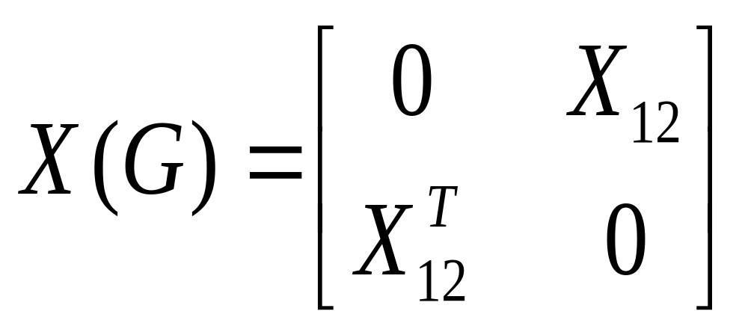
Matching & Adjacency Matrix
The adjacency matrix of a bipartite graph G can be written in the form
All the information about bipartite graph G is contained in X₁₂ matrix
April 24, 2003
MATH 323 Graph Theory Lecture 18

Slide 50
Matching
A matching V₁ into V₂ corresponds to a selection of the 1’s in the matrix X₁₂ such that no line (a row or a column) has more than one 1.
April 24, 2003
MATH 323 Graph Theory Lecture 18

Slide 51
Example
The situation is represented by the graph.
s₁
c₁
s₂
c₂
s₃
s₄
c₃
v₁
v₂
s₅
Committees
Senators
April 24, 2003
MATH 323 Graph Theory Lecture 18

Slide 52
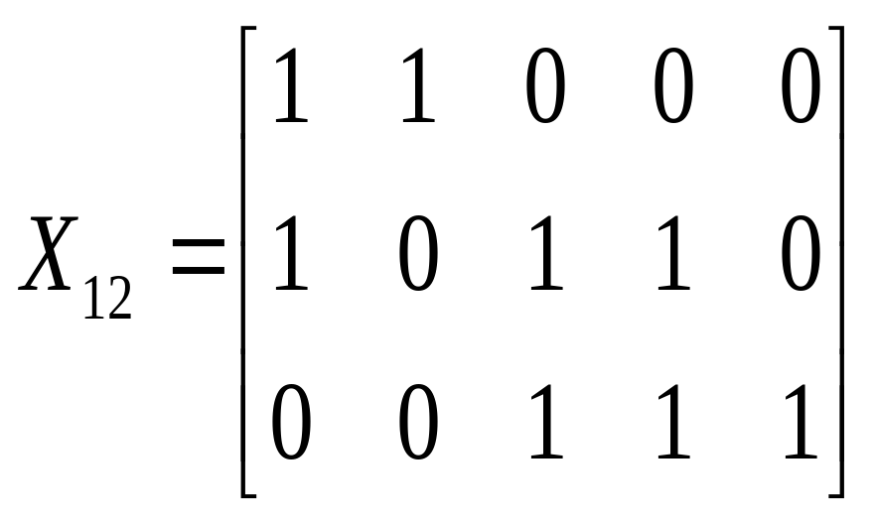
Committee & Senator
In this situation, the graph X₁₂ is:
April 24, 2003
MATH 323 Graph Theory Lecture 18

Slide 53
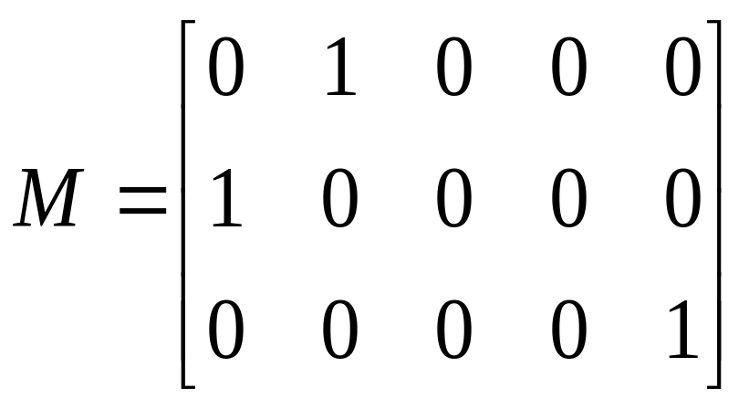
Matching
A complete matching of V₁ into V₂ is given by:
April 24, 2003
MATH 323 Graph Theory Lecture 18

Slide 54
Exercise
Find the matching using the adjacency matrix.
p₁
a₁
p₂
a₂
p₃
a₃
p₄
a₄
v₁
p₅
v₂
p₆
Applicants
Positions
April 24, 2003
MATH 323 Graph Theory Lecture 18

Slide 55
Covering
A set C of vertices in a graph G is said to cover the edges of G if every edge of G is incident with at least one vertex of C. Such a set C is called an edge cover of G.
Or
A set E of edges in a graph G is said to cover G if every edge in G is incident on at least one edge in E. A set of edges E that covers a graph G is said to be an edge covering or simply covering.
May 1, 2003
MATH 323 Graph Theory Lecture 19

Slide 56
Example
a
b
c
d
e
f
The set {b, d, e, a} is an edge cover.
The set {a, e, f} is also an edge cover.
Exercise: Find some other edge cover sets.
May 1, 2003
MATH 323 Graph Theory Lecture 19

Slide 57
Application
The above graph represents the street map of a part of a city.
May 1, 2003
MATH 323 Graph Theory Lecture 19

Slide 58
Application
Each of the vertices is a potential trouble spot and must be kept under the surveillance of a patrol car. What is the minimum of patrol cars required?
May 1, 2003
MATH 323 Graph Theory Lecture 19

Slide 59
Solution
Since there are 11 vertices and no edge can cover more that two, less than six edges cannot cover the graph.
The minimum required number of patrol cars is six.
May 1, 2003
MATH 323 Graph Theory Lecture 19

Slide 60
König-Egerváry Theorem
Let G be a bipartite graph. The maximum number of edges in a matching in G equals the minimum number of vertices in an edge cover of G.
Note: The minimum of one thing is related to maximum of something else.
May 1, 2003
MATH 323 Graph Theory Lecture 19

Slide 61
More Next Time
MATH 323 Graph Theory Lecture 11

